Slide 1
Introduction to Microsoft ADO.Net
Presenter: Abdul Rub

Slide 2
What is ADO.Net?
Ms Access
XML
DotNet Application
SQL Server
ADO.Net
Oracle
Web App
Console App
Windows App
Data Provider
Database
Data Sources

Slide 3
What is ADO.Net?
NameSpaces
Data Providers
Databases
SQLClient
System.Data.SQLClient
SQL Server
OracleClient
System.Data.OracleClient
Oracle
OleDb
System.Data.OleDb
Ms Access
Odbc
System.Data.Odbc
Configured Databases

Slide 4
What is ADO.Net?
Data Providers
Common Classes
SQLClient
Connection
OracleClient
Command
OleDb
DataReader
Odbc
DataAdapter

Slide 5
What is ADO.Net?
Data Providers
Connection Class
SQLClient
SQLConnection
OracleClient
OracleConnection
OleDb
OleDbConnection
Odbc
OdbcConnection

Slide 6
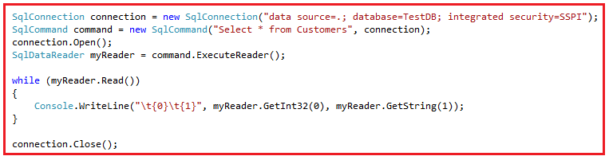
System.Data.SQLClient

Slide 7
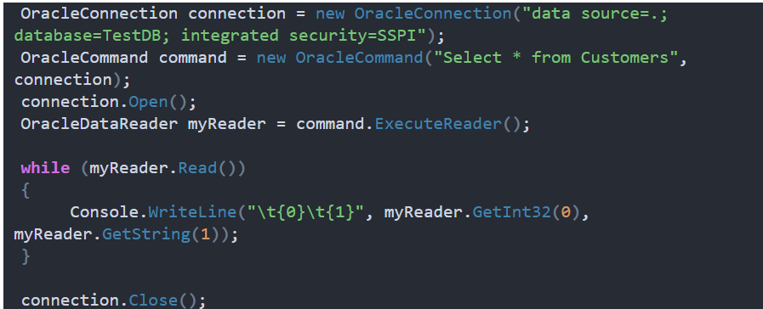
System.Data.OracleClient

Slide 8
What is ADO.Net?
ADO.NET provides a bridge between the front end controls and the back end database.
ADO.NET is a module of .Net Framework which is used to establish connection between application and data sources.
Data sources can be such as SQL Server and XML.
ADO.NET consists of classes that can be used to connect, retrieve, insert and delete data.
All the ADO.NET classes are located into System.Data.dll and integrated with XML classes located into System.Xml.dll.

Slide 9
What is ADO.Net?
ADO.NET stands for ActiveX Data Object.
It is a database access technology created by Microsoft as part of its .NET framework that can access any kind of data source.
It’s a set of object-oriented classes that provides a rich set of data components to create high-performance, reliable and scalable database applications.

Slide 10
What is ADO.Net?
The ADO.NET is one of the Microsoft’s data access technology which is used to communicate between the .NET Application (Console, WCF, WPF, Windows, MVC, Web Form, etc.) and data sources such as SQL Server, Oracle, MySQL, XML document, etc
ADO.NET consists of a set of classes that can be used to connect, retrieve, insert, update and delete data (i.e. performing CRUD operation) from data sources.
ADO.NET mainly uses System.Data.dll and System.Xml.dll.

Slide 11
What types of Applications use ADO.NET?
ADO.NET can be used to develop any type of .NET application. The following are some of the .NET applications where you can ADO.NET Data Access Technology to interact with a data source.
ASP.NET Web Form Applications
Windows Form Applications
ASP.NET MVC Application
Console Applications
ASP.NET Web API Applications

Slide 12
Components of ADO.NET
Components are designed for data manipulation and faster data access.
Connection, Command, DataReader, DataAdapter, DataSet, and DataView are the components of ADO.NET that are used to perform database operations.
ADO.NET has two main components that are used for accessing and manipulating data. They are as follows:
Data provider
DataSet.

Slide 13
What is .NET Data Providers?
The .Net Application can not directly execute our SQL code, it only understands C#. So, if a .NET application needs to retrieve data or to do some insert, update, and delete operations from or to a database, then the .NET application needs to
Connect to the Database
Prepare an SQL Command
Execute the Command
Retrieve the results and display them in the application

Slide 14

ADO.Net with ??
Web Application
Desktop Application

Slide 15
Copy() & Clone() Methods Of DataTable in ADO.Net
PART-7
Presenter: Abdul Rub

Slide 16
Copy() & Clone() Methods Of DataTable in ADO.Net
DataTable.Copy() returns a DataTable with the structure and data of the DataTable.
DataTable.Clone() only returns the structure of the DataTable, not the rows or data of the DataTable.

